Slide 1
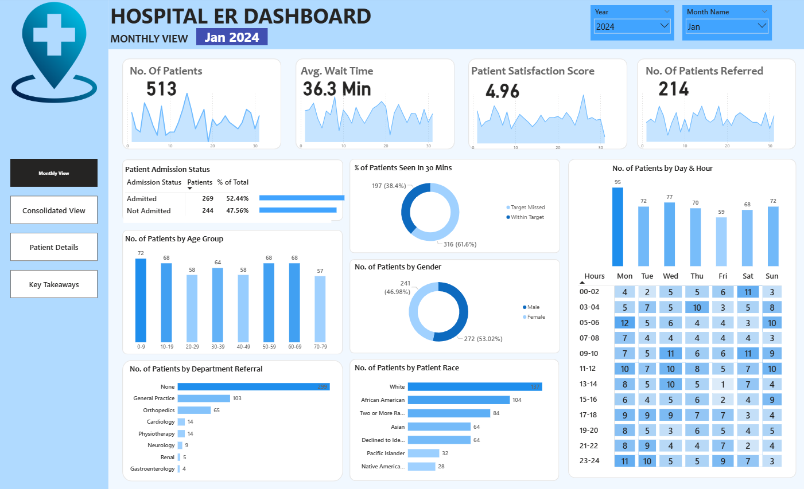

Slide 2
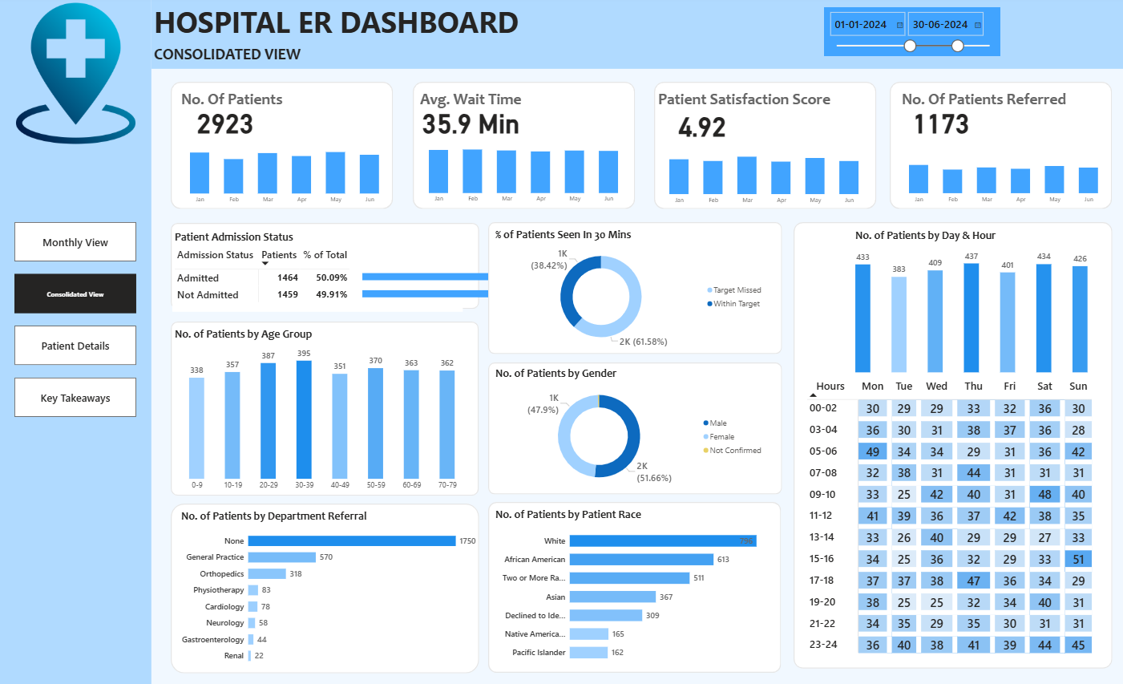

Slide 3
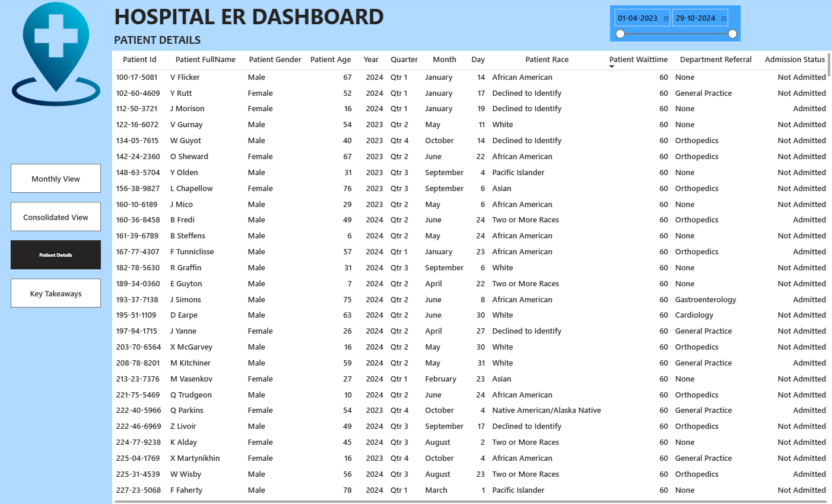

Slide 4
HOSPITAL EMERGENCY ROOM DASHBOARD
STEPS IN PROJECT
Requirement Gathering/ Business Requirements
Data Walkthrough
Data Connection
Data Cleaning / Quality Check
Data Modeling
Data Processing
DAX Calculations
Dashboard Lay outing
Charts Development and Formatting
Dashboard / Report Development
Insights Generation

Slide 5
HOSPITAL EMERGENCY ROOM DASHBOARD
DASHBOARDS - 4
Monthly View
Consolidated View
Patient Details
Key Takeaways

Slide 6
HOSPITAL EMERGENCY ROOM DASHBOARD
BUSINESS REQUIREMENTS
KPI’s Requirements
To enhance operational efficiency and provide actionable insights into emergency room performance, we need to create a Hospital Emergency Room Analysis Dashboard in Power BI. This solution will enable stakeholders to track, analyze, and make data-driven decisions regarding patient management and service optimization.
Number of Patients:
Measure the total number of patients visiting the ER daily.
Display a daily trend using an area sparkline to understand patterns over time, such as peak days or seasonal trends.
Average Wait Time:
Calculate the average time patients wait before being attended to by a medical professional.
Use an area sparkline to show daily fluctuations and identify days with higher wait times that may require operational adjustments.
Patient Satisfaction Score:
Analyze the average satisfaction score of patients on a daily basis to evaluate the quality of service provided.
Present a daily trend using an area sparkline to identify dips in satisfaction and correlate them with operational challenges or peak times.
Number of Patients Referred:
Count the number of patients referred to specific departments from the ER each day.
Use an area sparkline to track daily trends and identify departments with high referral rates, which may require additional resources.

Slide 7
HOSPITAL EMERGENCY ROOM DASHBOARD
BUSINESS REQUIREMENTS
Dashboard 1: Monthly View
Objective: Monitor key metrics and trends on a month-by-month basis to identify patterns and areas for improvement.
Charts to Develop:
Patient Admission Status: Track admitted vs. non-admitted patients.
Patient Age Distribution: Group patients by 10-year age intervals.
Department Referrals: Analyze referral trends across different departments.
Timeliness: Measure the percentage of patients seen within 30 minutes.
Gender Analysis: Visualize patient distribution by gender.
Racial Demographics: Analyze patient data by race.
Time Analysis: Assess patient volume by day and hour.

Slide 8
HOSPITAL EMERGENCY ROOM DASHBOARD
BUSINESS REQUIREMENTS
Dashboard 2: Consolidated View
Objective: Provide a holistic summary of hospital performance for a selected date range.
Charts to Develop:
Similar metrics as the Monthly View, but aggregated over a customizable date range for broader insights and trend analysis

Slide 9
HOSPITAL EMERGENCY ROOM DASHBOARD
BUSINESS REQUIREMENTS
Dashboard 3: Patient Details
Objective: Offer granular insights into patient-level data to enable detailed analysis and troubleshooting.
Charts to Develop: A grid displaying essential fields:
Patient ID
Patient Full Name
Gender
Age
Admission Date
Patient Race
Wait Time
Department Referral
Admission Status

Slide 10
HOSPITAL EMERGENCY ROOM DASHBOARD
BUSINESS REQUIREMENTS
Dashboard 4: Consolidated View
Objective: Summarize the findings from all dashboards to provide clear and actionable insights for stakeholders.
Charts to Develop:
Descriptive analysis of each metric and visualization, including patterns, anomalies, and actionable recommendations to optimize emergency room operations and patient care.

Slide 11
HOSPITAL EMERGENCY ROOM DASHBOARD
BUSINESS ANALYSIS
KPI’s Requirements
The emergency room dataset, covering a period of 19 months, records a total of 9,216 unique patients. After analysis of the data, it is clear that patients came to ER were in high density, mostly for general practice and Orthopedics. All patients have moderate satisfactory level.
Number of Patients:
The total number of patients that came in a month is approximately 500, and in an average of 18-20 patient a day. On peak days or seasonal trends, the count of patients rises to 22-25.
Average Wait Time:
The monthly average time patients wait before being attended to by a medical professional is 36.3 minutes. There is not any specific days where the wait time is higher so we should do adjustments in everyday work system.
Patient Satisfaction Score:
The average satisfaction score of patients on a daily basis to evaluate the quality of service provided is 4.96. As per analysis satisfaction score gets lower in ending days of month as per high wait time for patients.
Number of Patients Referred:
The number of patients referred to specific departments from the ER in month is 214. That means in average 7-8 patients per day.

Slide 12
HOSPITAL EMERGENCY ROOM DASHBOARD
Dashboard 2: Consolidated View
Charts Analysis:
In this page all the insights of the first dashboard will be present for certain range of time i.e. from January 1 2024 to June 30 2024.
Number of patients that came in this time span were 2923, in that most patient came in May (519) and least number of patient came in February (431).
The average wait time of the patient was 35.9 minutes, and similarly every month no improvement in waiting time for any patient.
Most number of referred patients came in the month of January and number of patients that were referred in this time range were 1173.
Status of patients that were admitted in the ER were 1464, and patients that were not admitted in the ER 1459 as they came for their routine check ups.
1000 patients were examined in less then 30 minutes and 2000 patients were missed to be examined within 30 minutes. That means more patients had taken more than 30 minutes to get examined in the ER.
In this ER number of female patients that came for checkup is 1000 were as 2000 male patients came in this time span of 6 months. In which most patients were from 30 - 39 age group.
The number of patients that came in the ER 1750 which were not referred for any department, and highest number of white patients(796) came to the ER in this time span.
In daily bases the number of patients that came were on Thursday(437) in which most patient preferred 5-6 as good time to come to ER.

Slide 13
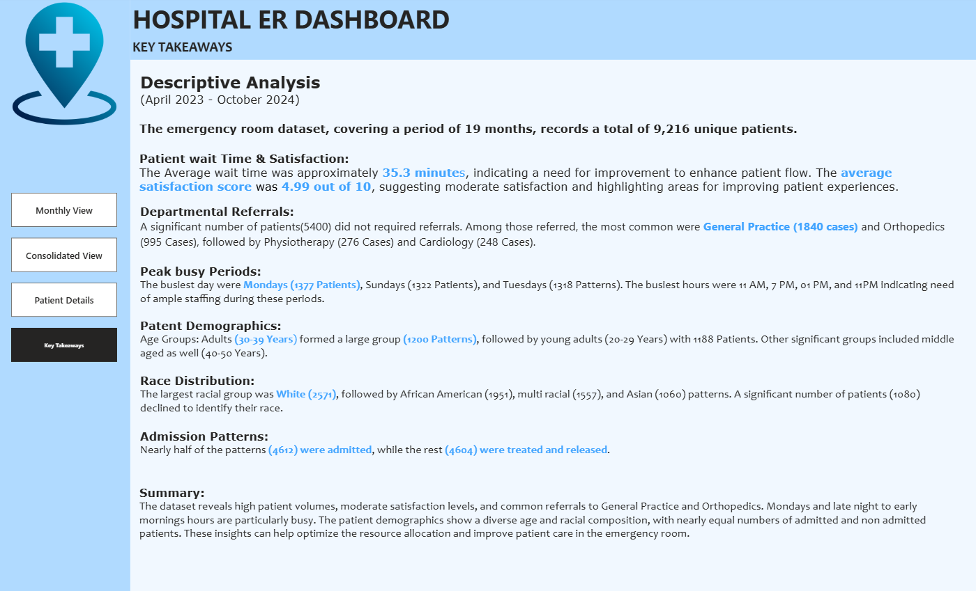

Slide 14
THANK YOU

